Slide 1
Bio& 241 A&P 1 Unit 3 / Lecture 3

Slide 2
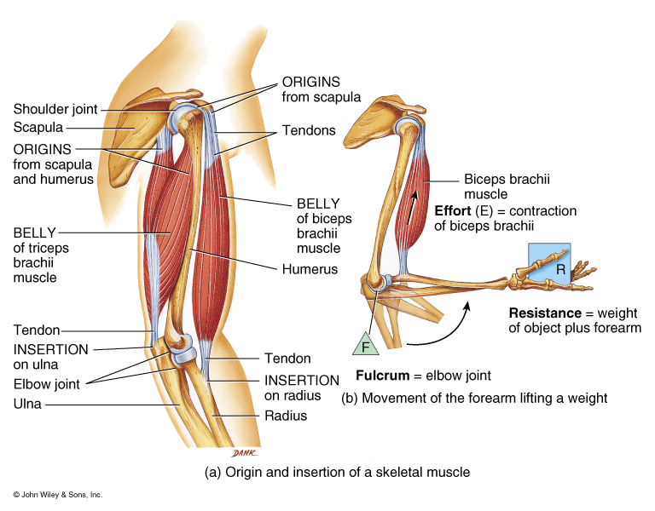
Actions of Antagonistic Muscles
Antagonist
Prime mover

Slide 3
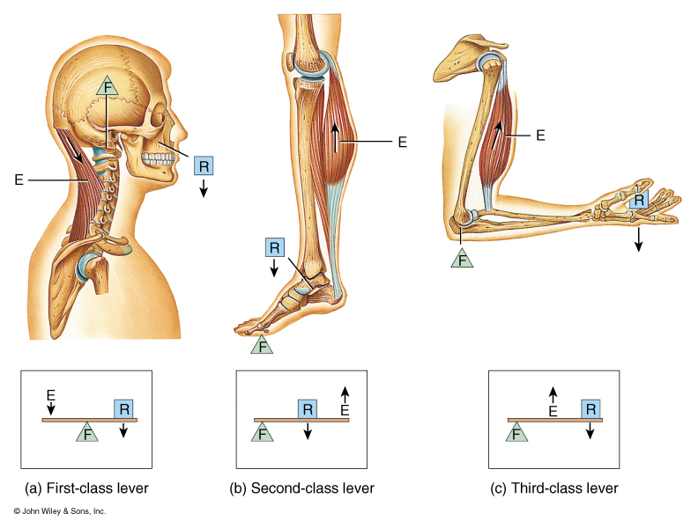
Properties of Muscle Contraction

Slide 4
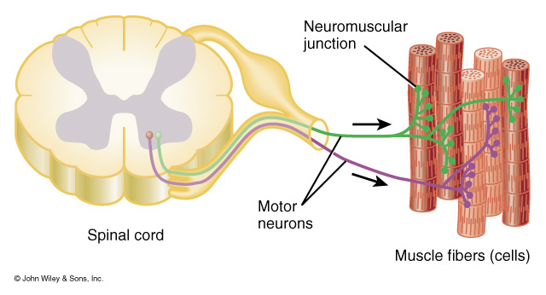
Motor Unit
All the muscle fibers (cells) innervated by the same motor neuron
All-or-None Principle: All muscle fibers that make up a motor unit contract
fully together. This principle holds true at the sarcomere, myofibril, and
muscle fiber levels as well. Partial contraction occurs at the muscle level
because all motor units are not contracting at the same time.
Recruitment: The process by which the number of actively contracting
motor units is increased.

Slide 5
Types of Muscle Contraction
Isotonic contraction:
a. Concentric isotonic contraction: Overall length of a muscle decreases during contraction to produce movement.
b. Eccentric isotonic contraction: Overall length of a muscle increases during muscle contraction, i.e., when an antagonistic muscle contracts against its
agonist.
2. Isometric contraction: a contraction where considerable muscle tension is generated without shortening of the muscle.

Slide 6
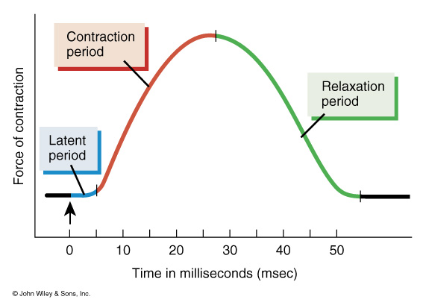
Myogram of a Simple Twitch
Simple twitch: Brief contraction of all fibers in a motor unit in response to
a single stimulus.

Slide 7
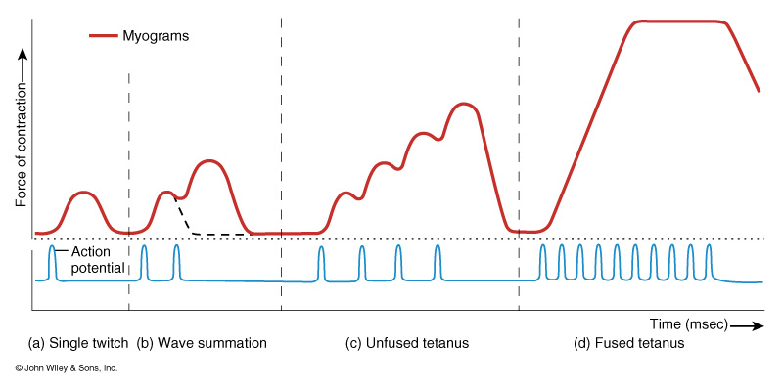
Myograms Created by Multiple Stimuli
Wave Summation: Two stimuli that occur close together so that the second
stimulus occurs before the the muscle can completely relax. Increased force of contraction is due to recruitment of motor units.
Unfused or Incomplete Tetanus: Due multiple stimuli that cause repeated
wave summations that increase force of contraction due to recruitment.

Slide 8
Myograms Created by Multiple Stimuli
Fused or Complete Tetanus: A sustained maximum contraction in which
individual contractions are not discernable. In fused tetanus, multiple stimuli are occurring so fast, the muscle does not undergo any relaxation.

Slide 9
Tension Produced by Contracting Skeletal Muscles
Internal tension: The force created by the shortening of sarcomeres and myofibrils within a muscle cell or fiber.
External tension: The force transferred from contracting muscle cells to their connective tissues (epimysium, perimysium, and endomysium) and tendons they become part of.
Because of the “series elastic elements” within this connective tissue, external tension builds slowly during early contraction periods and then builds more rapidly, transferring the tension to the force that moves bones at joints.

Slide 10
Tension Produced by Contracting Skeletal Muscles
Internal tension
External
tension

Slide 11
Receptors in Muscle
Muscle spindle
Detect dynamic and static changes in muscle length
Stretch reflex
Stretch on muscle causes reflex contraction
Golgi tendon organ (GTO)
Monitor tension developed in muscle
Prevents damage during excessive force generation
Stimulation results in reflex relaxation of muscle

Slide 12
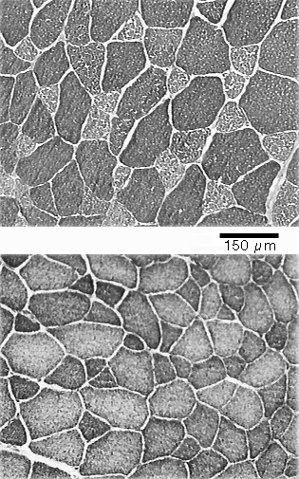
Three Types of Skeletal Muscle Fibers
Slow Oxidative
Fast Glycolytic
Fast Oxidative-Glycolytic

Slide 13
Structural Characteristics of the Three Fibers
Slow Oxidative (Type 1, ST, SO) | Fast Oxidative (Type 2a, FOG) | Fast Glycolytic Type 2b, FG)
High Myoglobin | High Myoglobin | Low Myoglobin
Many Mitochondria | Many Mitochondria | Few Mitochondria
Many Capillaries | Many Capillaries | Few Capillaries
Red in Color | Red-pink in Color | White (Pale pink) in color

Slide 14
Functional Characteristics of the Three Fibers
Slow Oxidative | Fast Oxidative | Fast Glycolytic
Slow rate of ATP hydrolysis | Fast rate of ATP hydrolysis | Fast rate of ATP hydrolysis
Slow contraction speed | Fast contraction speed | Fast contraction speed
High fatigue resistance | Intermediate fatigue resistance | Low fatigue resistance
Low glycogen stores | Intermediate glycogen stores | High glycogen stores

Slide 15
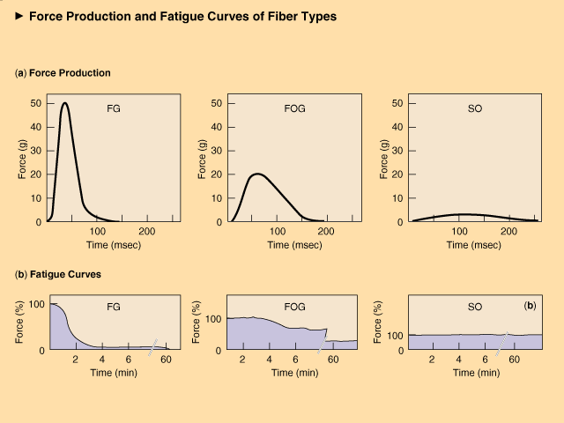

Slide 16
Functional Characteristics of the Three Fibers
Slow Oxidative | Fast Oxidative | Fast Glycolytic
1st recruitment | 2nd recruitment | 3rd recruitment
Most abundant in postural muscles | Most abundant in leg muscles | Most abundant in arm muscles
Involved in endurance activities | Involved in walking or sprinting | Involved in rapid, intense, short duration activities

Slide 17
Fiber Types and Performance
Power athletes
Sprinters
Possess high percentage of fast fibers
Endurance athletes
Distance runners
Have high percentage of slow fibers
Others
Weight lifters and nonathletes
Have about 50% slow and 50% fast fibers

Slide 18
Alteration of Fiber Type by Training
Endurance and resistance training
Cannot change fast fibers to slow fibers
Can result in shift from Type IIb to IIa fibers
Toward more oxidative properties

Slide 19
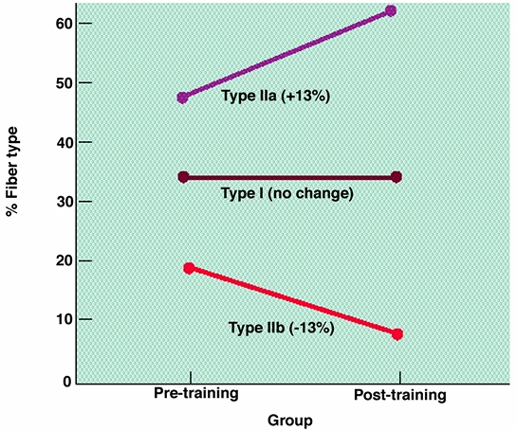
Training-Induced Changes in Muscle Fiber Type

Slide 20
Age-Related Changes in Skeletal Muscle
Aging is associated with a loss of muscle mass
Rate increases after 50 years of age
Regular exercise training can improve strength and endurance
Cannot completely eliminate the age-related loss in muscle mass

Slide 21
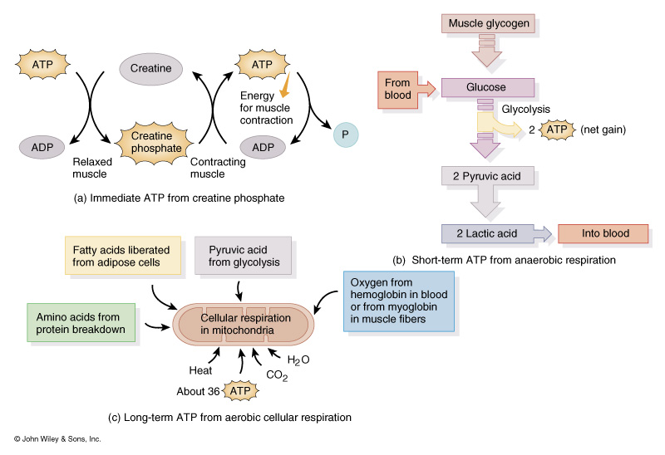
ATP Production for Muscle Contraction

Slide 22
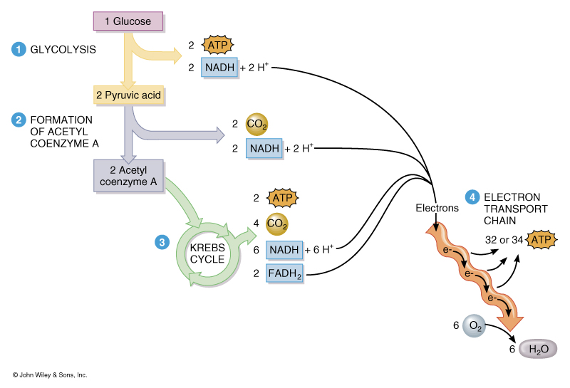
Overview of Cellular Respiration
ATP generation
Glycolysis:
Total 4
Used 2
Net gain 2
Krebs Cycle:
Net gain 2
ETC:
Net gain
32 or 34
Total 36 or 38

Slide 23
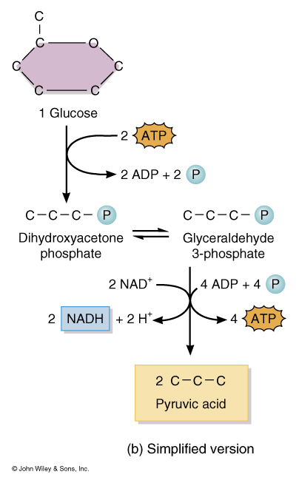
Glycolysis 1. Converting glucose to glyceraldehyde 3-phosphate require the use of two ATP. 2. Converting glyceraldehyde 3-phosphate to pyruvic acid produces 4 ATP. Products: 2 molecules of Pyruvic Acid 2 ATP 2 NADH

Slide 24
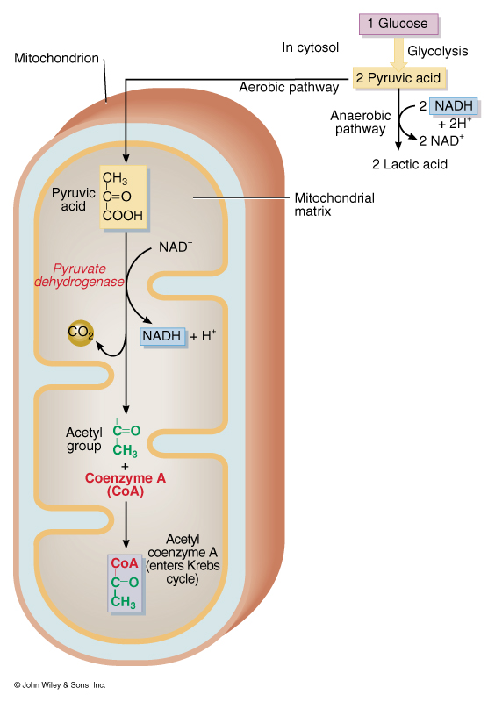
Formation of Acetyl Coenzyme-A The conversion of Pyruvic acid into Acetyl Coenzyme-A produces no ATP directly Products: 2 Acetyl-CoA 2 NADH 2 CO2

Slide 25
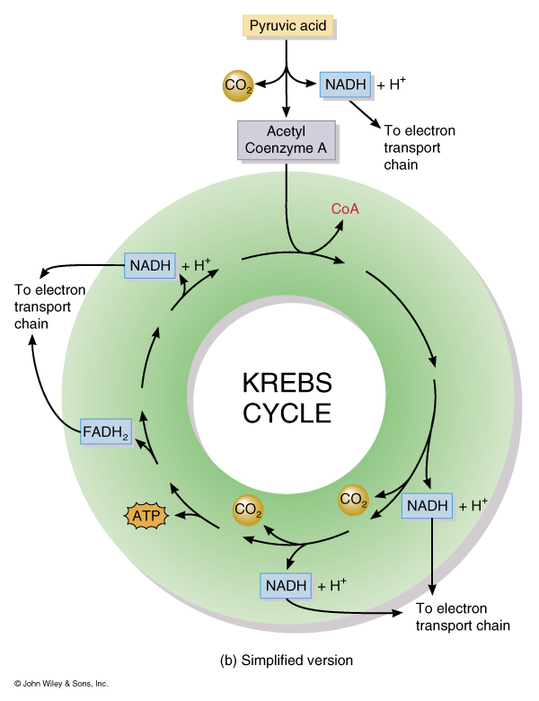
Kreb’s Cycle Produces one GTP per molecule of Acteyl-COA for a net gain of two per glucose molecule. This GTP is rapidly converted to ATP Products: NADH 6 FADH2 2 GTP 2 CO2 4

Slide 26
Chemiosmotic generation of ATP
Electron Transport Chain
A series of Oxidative Phosphorylation reactions
Oxidation = the removal of electrons from a molecule and results in a decrease in the energy content of the molecule. Because most biological reactions involve the loss of hydrogen atoms, they are called dehydrogenation reactions.
Reduction = the opposite of oxidation; the addition of electrons to a molecule, and results in an increase in the energy content of the molecule.

Slide 27
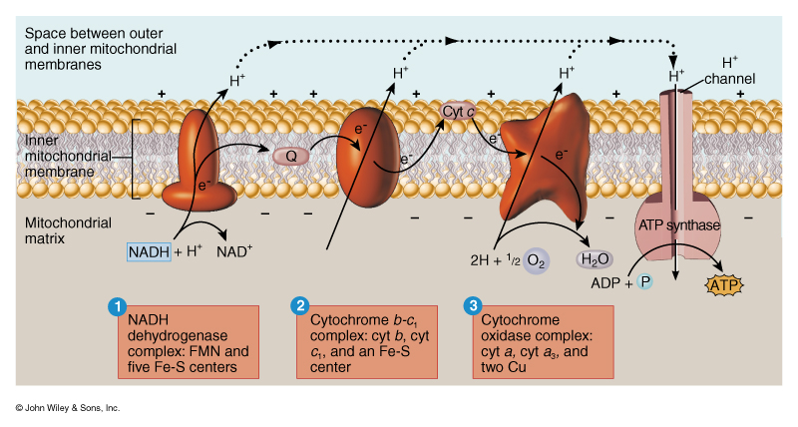
Chemiosmotic generation of ATP
ATP production:
NADH from Glycolysis
2 NADH= 6 ATP or 4ATP
NADH from Acetyl-COA
2 NADH= 6 ATP
NADH from Kreb’s Cycle:
6 NADH= 18 ATP
FADH2 from Kreb’s
2 FADH2= 4 ATP
TOTAL 32 or 34

